Slide 1

The APC Convention - ‘Social Value: What is the point?’
Lunchtime Activities – Don’t forget to get a stamp from exhibitors and table hosts to be in with a chance of winning a Big Issue North goody bag filled with Christmas items designed by Stanley Chow!

Slide 2













The Underhall - Meet APC partners

Slide 3

The Rylands Room
LIVE WELL IN THE RYLANDS ROOM
A chance for attendees to talk to GM Live Well team, feedback on emerging hallmarks of Live Well centres and spaces and link into locality work.

Slide 4
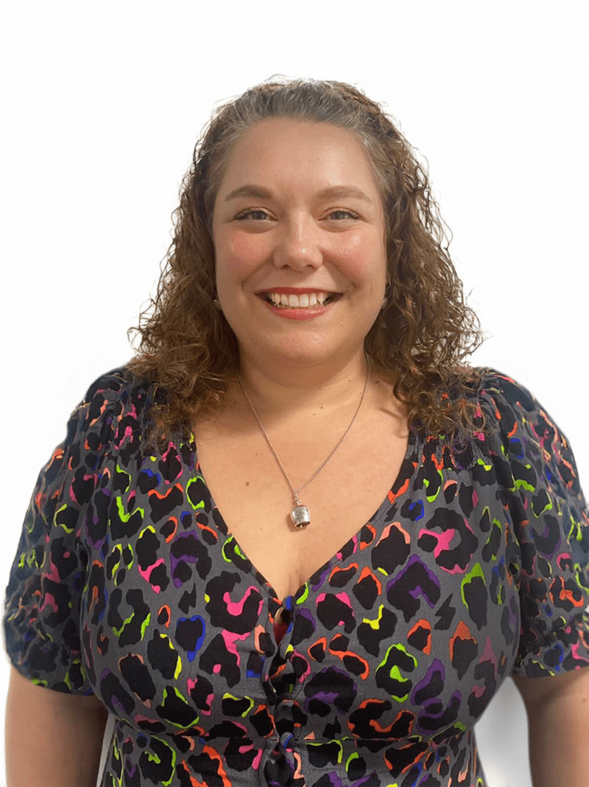
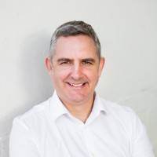
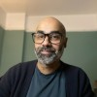
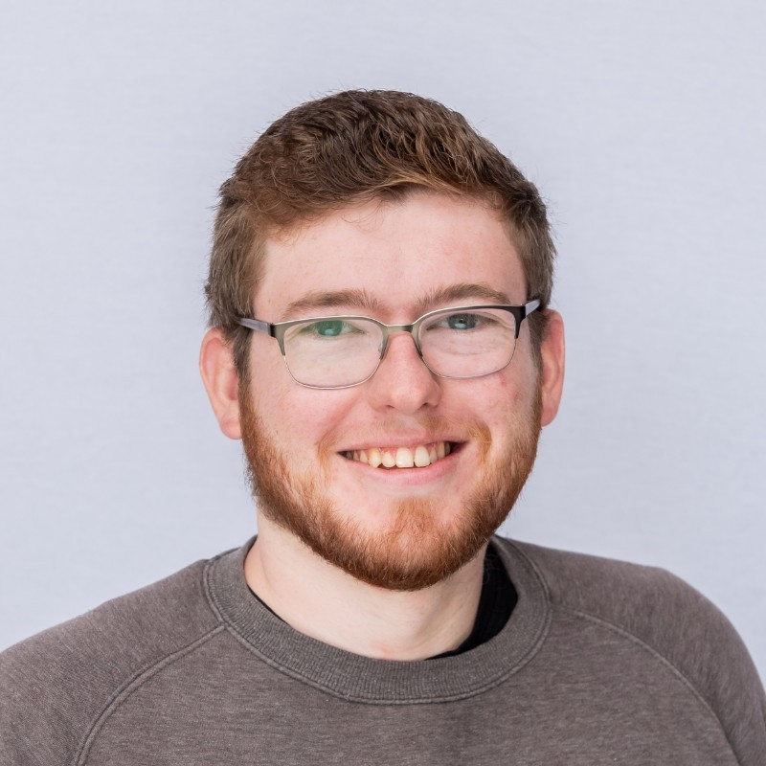
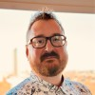
The Ballroom – Table 1
Meet the board members of The Greater Manchester Alternative provider Collaborative CIC
GMAPC became a CIC in the summer of 2025 with a board of directors appointed to lead our development into a strategic vehicle for collaborative contracting at scale. This is an opportunity to meet the new CIC board and find out more about their expertise, views and priorities for aligning with the NHS 10 Year Plan and evolving commissioning arrangements in GM.
Michelle Hill
Tom
Harte
Aydin
Djemal
Daniel
Walsh
Ben
Whalley

Slide 5


The Ballroom – Tables 2 - 5
A showcase of all things Trafford
Learn about how social businesses are partnering with Trafford Council to bring innovation in service to Trafford communities through Social Value, community projects, the changing futures programme and local infrastructure.

Slide 6
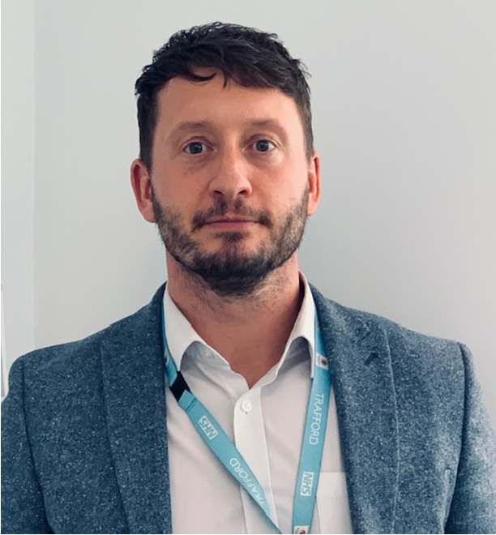

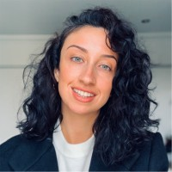
The Ballroom – Table 2
Changing Futures in Trafford
Changing Futures Trafford is a year-long programme, focused on supporting people who experience a combination of homelessness, substance misuse, mental health issues, domestic abuse and contact with the criminal justice system.
Tom
Maloney – Programme Director Health & Care Trafford Council
Caroline Luckham – Delivery Lead Changing Futures Trafford

Slide 7
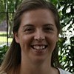
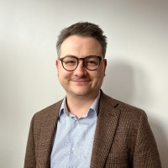
The Ballroom – Table 3
Trafford Local Infrstructure – Trafford Community Collective
Trafford Community Collective is a member-led organisation that supports the development of the Voluntary, Community, Faith and Social Enterprise (VCFSE) sector across Trafford by promoting a Collective and partnership approach to service development and delivery. We call the it the Collective for short!
Nathalie Haslam – Deputy CEO Trafford Community Collective
Mitch Salter – Strategic Partnership Manager Trafford Council

Slide 8
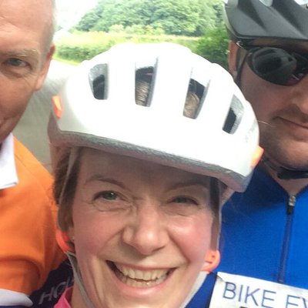
The Ballroom – Table 4
Healthy Communities in Trafford
Learn more about how Sale Central PCN works together with Sale Moor Community Partnership to improve the health and wellbeing of the residents of Sale Moor and the wider Trafford Community
Dr Yvonne Burke – Health Inequalities Lead Sale Central PCN
Kirsty Harkins – Sale Moor Community Partnership

Slide 9
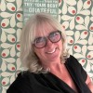
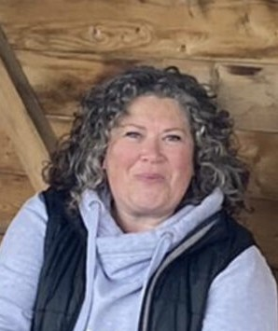
The Ballroom – Table 5
Place-based work in Trafford
Drop in here to learn about how the neighbourhood model is developing in Trafford and how partnership working is fueling improved outcomes for the people of Trafford
Bernadette
Ashcroft –
CEO Trafford Collective
Julia Worthington - Trafford Local Care Organisation Integrated Neighbourhood Lead

Slide 10
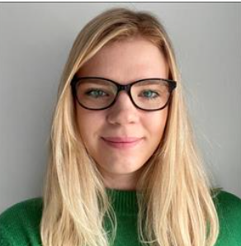
The Ballroom – Table 6
Trafford’s Recovery Community
Drop in here to learn about how Trafford Community Collective and Trafford Council have come together to develop Trafford’s Recovery Community for those affected by substance misuse
Aimee Hodgkinson – Public Health Commissioning Manager – Drugs and Alcohol
Verity Gardner – Recovery Community Facilitator

Slide 11
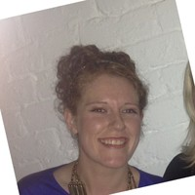
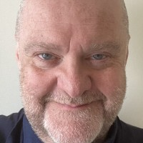
The Ballroom – Table 7
Trafford’s Social Value Initiative
Drop in here to learn about how Trafford Community Collective and Trafford Council have come together to embed Social Value throughout their organisations and supply chains
Caroline Lewis – Social Value Coordinator Trafford Council
Simon Locke – Deputy Chief Exec Trafford Carers Centre

Slide 12
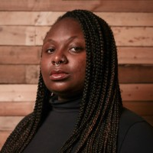
The Ballroom – Table 8
Crafting for mindfulness
The APC’s very own Ayisatu Oladunni will be hosting creative activities to help us learn simple techniques to practice mindfulness that can help manage mental health in a world that is so often overwhelming.
Ayisatu Oladunni

Slide 13
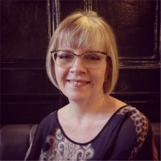
The Ballroom – Table 9
Exploring T-Levels and placement opportunities for young people
Following a growth of momentum to engage with young people and communities and provide developmental opportunities to support them into work, as part of the sector’s civic responsibility. This session will: a) provide an opportunity for you to find out more about a range of approaches to support this ambition and to strengthen your future workforce pipelines b) hear your views on the sectors readiness, barriers, and opportunities around these approaches, to inform future work in this space.
Sue
Howard

Slide 14
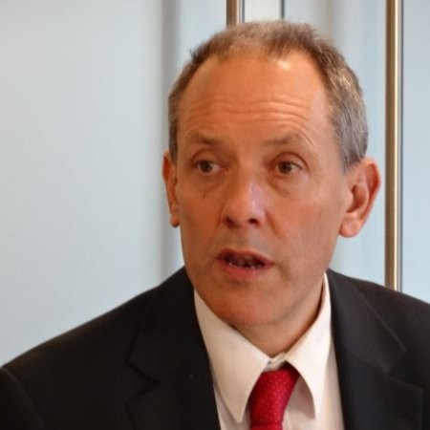
The Ballroom – Table 10
Meet E3M and learn about their work
Jonathan Bland (Founder of E3M) will be hosting this drop in where you can learn about how E3M supports the growth and impact of social enterprises that trade in public service markets
Jonathan Bland

Slide 15
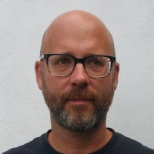
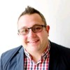
The Ballroom – Table 11
Meet Social Enterprise UK and learn about their work
Scott Darraugh and Dan Gregory will together host this table where you can learn about how and where Social Enterprise is advocating for businesses with a social purpose. Dan and Scott will also be discussing the newly launched report Ahead Of The Curve On Healthcare – Social Enterprises and The Government’s 10 Year Plan
Dan
Gregory
Scott
Darraugh

Slide 16
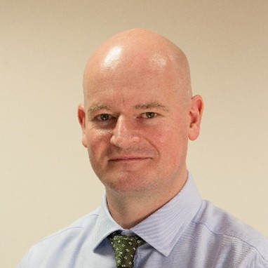
The Ballroom – Table 12
Have your say on NHS GM’s new operating model
Deputy Chief Executive at NHS GM, Professor Colin Scales invites comment on the draft new operating model for NHS GM.
Prof. Colin Scales

Slide 17
If you’d like to find out more about The APC, become a partner or just meet the team contact us – info@gmapc.org.uk

