Slide 1


Slide 2
What’s On In The Main Hall?
Time | Session | Hosts/Guests
10.00 | Welcome! Meet your hosts: | Edna Robinson, Warren Heppolette and Nathan Parker
10.10 | Can the NHS do more to reduce social inequality? | Chair: Sir Richard Leese with Jane Pilkington, Fay Selvan and Liz Windsor-Welsh
11.00 | Comfort Break
11.05 | How can we ensure racial justice in the NHS? | Chair: Cllr Arooj Shah with Charles Kwaku-Odoi, Aydin Djemal and Roli Barker
12.00 | Lunch | Various Activities Throughout The Venue
12.50 | Welcome Back! | Edna Robinson, Warren Heppolette and Nathan Parker
13.00 | Primary care blueprint spotlight | Chair: Janet Crofts with Liz Windsor-Welsh and Tim Davison plus special guests: Dr Tim Dalton, Luvjit Kandula, Rob Bellingham, Dr Tracey Vell, Dr Chris Nortcliff, Dr Leigh Vallance.
13.55 | Comfort Break
14.00 | Is the MH system overloaded and how can we be part of the solution? | Chair: Simone Spray with Dr Iyabo Fatimilehin, Sandy Bering, Sam Palmer, Ben Whalley
15.00 | Thanks, Poetic Summary and What’s Next for The APC? | Edna Robinson, Warren Heppolette and Nathan Parker

Slide 3
The APC in numbers
Member organisations = 50 + waiting list
Our collective turnover is circa £200 million.
Annually, member organisations provide services to nearly 2 million people.
Collectively, there is 2,200 staff and nearly 1000 volunteers engaged
We have a presence on all 10 GM boroughs.

Slide 4
LUNCHTIME ACTIVITIES
Room | Activity
The Main Hall | TABLE 1 - Mapping GM with Franky Procter TABLE 3 - Art exhibition and Continuous Line Drawing Workshop with CAHN TABLE 5 - Free VCSE Data Maturity Assessments courtesy of 10GM and Data Orchard TABLE 9 - Trafford’s Neighbourhood Model – Working with Communities
The Rylands Room | Free Health Checks from GM Feds
The Foyer | Vegetarian ‘Grab and Go’ packed lunches
The Underhall | Meet the APC Providers!

Slide 5
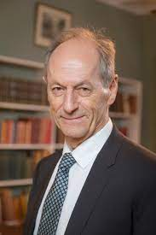
"A body that puts people in control of their own wellbeing and has a mission to achieve health equity is much to be welcomed. The new Greater Manchester Alternative Provider Collaborative shows the importance of pursuing health equity and environmental sustainability at the same time.“
Professor Sir Michael Marmot FRCP
Director, UCL Institute of Health Equity

Slide 6
Strategic Context
NHS reform placing providers in stronger position to influence and shape delivery
APC founded July ‘22 in response to this
Need for parity and respect for organisations that are effective and creative
Sponsored by The Greater Manchester Accord Agreement and GM ICB
Notes:
The APF has emerged following the signing of the GM VCSE Accord Agreement in September 2021. The agreement is a three-way collaboration agreement between the Greater Manchester Combined Authority, the Greater Manchester Health and Social Care Partnership and the GM Voluntary, Community and Social Enterprise (VCSE) Sector represented by the GM VCSE Leadership Group. The Accord will act as a framework for collaboration involving VCSE leaders and organisations in the delivery of the Greater Manchester Strategy, including the development of the strategic plan of the new GM Integrated Care System.

Slide 7
What’s On In The Main Hall?
Time | Session | Hosts/Guests
10.00 | Welcome! Meet your hosts: | Edna Robinson, Warren Heppolette and Nathan Parker
10.10 | Can the NHS do more to reduce social inequality? | Chair: Sir Richard Leese with Jane Pilkington, Fay Selvan and Liz Windsor-Welsh
11.00 | Comfort Break
11.05 | How can we ensure racial justice in the NHS? | Chair: Cllr Arooj Shah with Charles Kwaku-Odoi, Aydin Djemal and Roli Barker
12.00 | Lunch | Various Activities Throughout The Venue
12.50 | Welcome Back! | Edna Robinson, Warren Heppolette and Nathan Parker
13.00 | Primary care blueprint spotlight | Chair: Janet Crofts with Liz Windsor-Welsh and Tim Davison plus special guests: Dr Tim Dalton, Luvjit Kandula, Rob Bellingham, Dr Tracey Vell, Dr Chris Nortcliff, Dr Leigh Vallance.
13.55 | Comfort Break
14.00 | Is the MH system overloaded and how can we be part of the solution? | Chair: Simone Spray with Dr Iyabo Fatimilehin, Sandy Bering, Sam Palmer, Ben Whalley
15.00 | Thanks, Poetic Summary and What’s Next for The APC? | Edna Robinson, Warren Heppolette and Nathan Parker

Slide 8
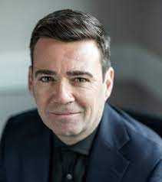
“There are many successful social enterprises already making a difference here in our city-region, and we want to support them to deliver the best possible outcomes for our communities. It’s great to see this new Alternative Provider Collaborative galvanising a collective, coherent platform to work within the wider health and social care system and tackle health inequalities in Greater Manchester.”
Mayor of Greater Manchester, Andy Burnham.

Slide 9
LUNCHTIME ACTIVITIES
Room | Activity
The Main Hall | TABLE 1 - Mapping GM with Franky Procter TABLE 3 - Art exhibition and Continuous Line Drawing Workshop with CAHN TABLE 5 - Free VCSE Data Maturity Assessments courtesy of 10GM and Data Orchard TABLE 9 - Trafford’s Neighbourhood Model – Working with Communities
The Rylands Room | Free Health Checks from GM Feds
The Foyer | Vegetarian ‘Grab and Go’ packed lunches
The Underhall | Meet the APC Providers!

Slide 10
APC – Purpose
To create an infrastructure for social enterprise and charity providers to engage with the ICS on a GM footprint.
To scale up the social business sector in Greater Manchester
To innovate to tackle inequality
To provide high quality service solutions
To bring new investment into the system
To grow the confidence of VCSE organisations

Slide 11

APC – Values
Collaboration
Creativity
Influence
Courage
Sustainability
Notes:
Collaboration
Encouraging mutual collaboration can help foster a rewarding and mutually respectful relationship between members. This will help deliver and achieve the overall goals of The APF.
We will create an environment where we can share insight and knowledge and co-produce ideas that support people and communities to get to where they want to be, sharing intellectual property risk free with an open source approach
We will work together on projects cooperatively
Build trust, alignment and accountability
Be inclusive, sharing and connected
Navigate change collectively
Creativity
We will encourage diversity of thought and lived experience in our service development.
We will be a think tank and offer commentary on policy, innovation, testing, prototyping, myth busting, etc.
We will offer innovation and alternatives with provider solutions to insoluble issues within health and social care
Be thought leaders
Influence
We will speak up with a shared voice and use our collective bargaining power
Lobby and be a locus of influence on a local and national platform
Use and expand our links to wider system and other bodies to ensure representation across the new ICB/ICS structure in GM.
Be an exemplar of best practice.
Courage
We will collectively bolster members to be courageous and tenacious when challenging the healthcare status quo in GM
Increase market share for the VCSE sector with a clear offer to the wider ecosystem.
Be fleet of foot, dynamic, nimble, lean, agile and with no red tape,
Be challenging
Call out unwarranted variation in health outcomes
Showcase innovation in terms of access and delivery.
Be aspirational towards smaller organisations
Be proactive in grasping opportunity
Sustainable
We will work towards a buoyant and resilient VCSE sector in GM
Invest & develop – partner through sub-contracting with smaller organisations
Support the sustainability and effectiveness of peers and organisations in APF?
Workforce issues - planning, retention, recruitment, EDI
Social impact/value – commissioning
Be a hub of expertise around procurement and commissioning – the art of the impossible.

Slide 12
What’s On In The Main Hall?
Time | Session | Hosts/Guests
10.00 | Welcome! Meet your hosts: | Edna Robinson, Warren Heppolette and Nathan Parker
10.10 | Can the NHS do more to reduce social inequality? | Chair: Sir Richard Leese with Jane Pilkington, Fay Selvan and Liz Windsor-Welsh
11.00 | Comfort Break
11.05 | How can we ensure racial justice in the NHS? | Chair: Cllr Arooj Shah with Charles Kwaku-Odoi, Aydin Djemal and Roli Barker
12.00 | Lunch | Various Activities Throughout The Venue
12.50 | Welcome Back! | Edna Robinson, Warren Heppolette and Nathan Parker
13.00 | Primary care blueprint spotlight | Chair: Janet Crofts with Liz Windsor-Welsh and Tim Davison plus special guests: Dr Tim Dalton, Luvjit Kandula, Rob Bellingham, Dr Tracey Vell, Dr Chris Nortcliff, Dr Leigh Vallance.
13.55 | Comfort Break
14.00 | Is the MH system overloaded and how can we be part of the solution? | Chair: Simone Spray with Dr Iyabo Fatimilehin, Sandy Bering, Sam Palmer, Ben Whalley
15.00 | Thanks, Poetic Summary and What’s Next for The APC? | Edna Robinson, Warren Heppolette and Nathan Parker

Slide 13
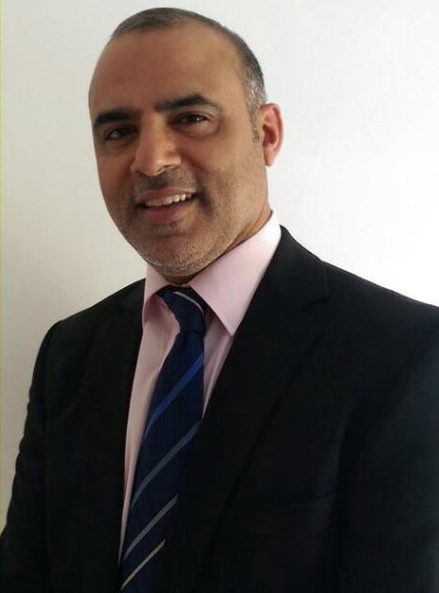
“The VCSE is an important partner for health and social care organisations and plays a key role in improving health and care outcomes for its communities. In this new world of collaboration VCSE will continue to play its vital role in the planning of care and supporting a greater shift towards prevention, self care and combating inequalities and disparities......it has a role to play in transformation, innovation and integration.” Non-Executive Director
NHS GM Integrated Care - Shazad Sarwar.

Slide 14
LUNCHTIME ACTIVITIES
Room | Activity
The Main Hall | TABLE 1 - Mapping GM with Franky Procter TABLE 3 - Art exhibition and Continuous Line Drawing Workshop with CAHN TABLE 5 - Free VCSE Data Maturity Assessments courtesy of 10GM and Data Orchard TABLE 9 - Trafford’s Neighbourhood Model – Working with Communities
The Rylands Room | Free Health Checks from GM Feds
The Foyer | Vegetarian ‘Grab and Go’ packed lunches
The Underhall | Meet the APC Providers!

Slide 15


What are our members saying?
“Health and social care will be more accessible to all at various levels and with the VCSE federation bringing creativity and freshness to parts of the system that we know our public are unhappy with.
We are strong and robust and will bring more of a unitedness to being part of health and social care ensuring with have thriving communities across Greater Manchester – Jenny Higson CEO
“Big Life are proud to be a founding member of the GM Alternative Provider Collaborative. With 30 years experience of working with public services to tackle inequalities, we are passionate about working in partnership to make change happen – Fay Selvan CEO

Slide 16
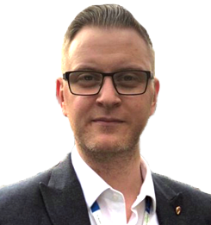
‘As alternative providers in the VCSFE sector we believe it is important to ensure all NHS expenditure is used to realise patient benefit. We are here to ensure that the NHS has provider support options that uphold the ethos of the NHS by enabling community and social value to ensure our communities thrive. With opportunities to commission for health care provision in a deregulated manner, we have come together to ensure that economy is on offer to limit the need for privatisation and to prevent under representation of local voices in Integrated Care System matters. We are together to uphold the value of integration, partnership, best practice and appropriate representation to keep the patient in focus whilst the pound comes under pressure.’ - Timothy A Davison / Director of Operations, Strategy and Transformation Mastercall Healthcare

Slide 17
What’s On In The Main Hall?
Time | Session | Hosts/Guests
10.00 | Welcome! Meet your hosts: | Edna Robinson, Warren Heppolette and Nathan Parker
10.10 | Can the NHS do more to reduce social inequality? | Chair: Sir Richard Leese with Jane Pilkington, Fay Selvan and Liz Windsor-Welsh
11.00 | Comfort Break
11.05 | How can we ensure racial justice in the NHS? | Chair: Cllr Arooj Shah with Charles Kwaku-Odoi, Aydin Djemal and Roli Barker
12.00 | Lunch | Various Activities Throughout The Venue
12.50 | Welcome Back! | Edna Robinson, Warren Heppolette and Nathan Parker
13.00 | Primary care blueprint spotlight | Chair: Janet Crofts with Liz Windsor-Welsh and Tim Davison plus special guests: Dr Tim Dalton, Luvjit Kandula, Rob Bellingham, Dr Tracey Vell, Dr Chris Nortcliff, Dr Leigh Vallance.
13.55 | Comfort Break
14.00 | Is the MH system overloaded and how can we be part of the solution? | Chair: Simone Spray with Dr Iyabo Fatimilehin, Sandy Bering, Sam Palmer, Ben Whalley
15.00 | Thanks, Poetic Summary and What’s Next for The APC? | Edna Robinson, Warren Heppolette and Nathan Parker

Slide 18













Supporting organisations:

Slide 19
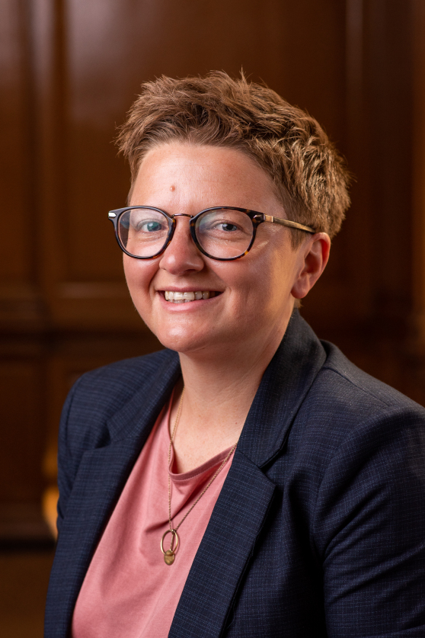
“Great to see the APC having a day to reflect on issues of social justice in GM. Wishing them well and sorry I can’t be there. I’m sure they will continue to make a difference in terms of what is available in GM to improve health and life chances” – Cllr Bev Craig. Leader Of Manchester City Council

Slide 20
LUNCHTIME ACTIVITIES
Room | Activity
The Main Hall | TABLE 1 - Mapping GM with Franky Procter TABLE 3 - Art exhibition and Continuous Line Drawing Workshop with CAHN TABLE 5 - Free VCSE Data Maturity Assessments courtesy of 10GM and Data Orchard TABLE 9 - Trafford’s Neighbourhood Model – Working with Communities
The Rylands Room | Free Health Checks from GM Feds
The Foyer | Vegetarian ‘Grab and Go’ packed lunches
The Underhall | Meet the APC Providers!

Slide 21












Founding members:

Slide 22
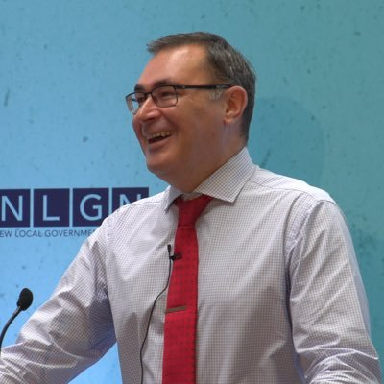
“Looking forward to seeing how we can improve care and generate some real innovation through social businesses in Greater Manchester” – Warren Heppolette. Chief Officer for Strategy & Innovation, NHS Greater Manchester

Slide 23
What’s On In The Main Hall?
Time | Session | Hosts/Guests
10.00 | Welcome! Meet your hosts: | Edna Robinson, Warren Heppolette and Nathan Parker
10.10 | Can the NHS do more to reduce social inequality? | Chair: Sir Richard Leese with Jane Pilkington, Fay Selvan and Liz Windsor-Welsh
11.00 | Comfort Break
11.05 | How can we ensure racial justice in the NHS? | Chair: Cllr Arooj Shah with Charles Kwaku-Odoi, Aydin Djemal and Roli Barker
12.00 | Lunch | Various Activities Throughout The Venue
12.50 | Welcome Back! | Edna Robinson, Warren Heppolette and Nathan Parker
13.00 | Primary care blueprint spotlight | Chair: Janet Crofts with Liz Windsor-Welsh and Tim Davison plus special guests: Dr Tim Dalton, Luvjit Kandula, Rob Bellingham, Dr Tracey Vell, Dr Chris Nortcliff, Dr Leigh Vallance.
13.55 | Comfort Break
14.00 | Is the MH system overloaded and how can we be part of the solution? | Chair: Simone Spray with Dr Iyabo Fatimilehin, Sandy Bering, Sam Palmer, Ben Whalley
15.00 | Thanks, Poetic Summary and What’s Next for The APC? | Edna Robinson, Warren Heppolette and Nathan Parker

Slide 24




With Thanks:

Slide 25
LUNCHTIME ACTIVITIES
Room | Activity
The Main Hall | TABLE 1 - Mapping GM with Franky Procter TABLE 3 - Art exhibition and Continuous Line Drawing Workshop with CAHN TABLE 5 - Free VCSE Data Maturity Assessments courtesy of 10GM and Data Orchard TABLE 9 - Trafford’s Neighbourhood Model – Working with Communities
The Rylands Room | Free Health Checks from GM Feds
The Foyer | Vegetarian ‘Grab and Go’ packed lunches
The Underhall | Meet the APC Providers!

Slide 26
If you’d like to find out more about The APC, become a member or just meet the team contact us – info@gmapc.org.uk

