Slide 1

The APC Convention - ‘Social Value: What is the point?’
Examining how social value is recognized as an essential driver of good public services

Slide 2
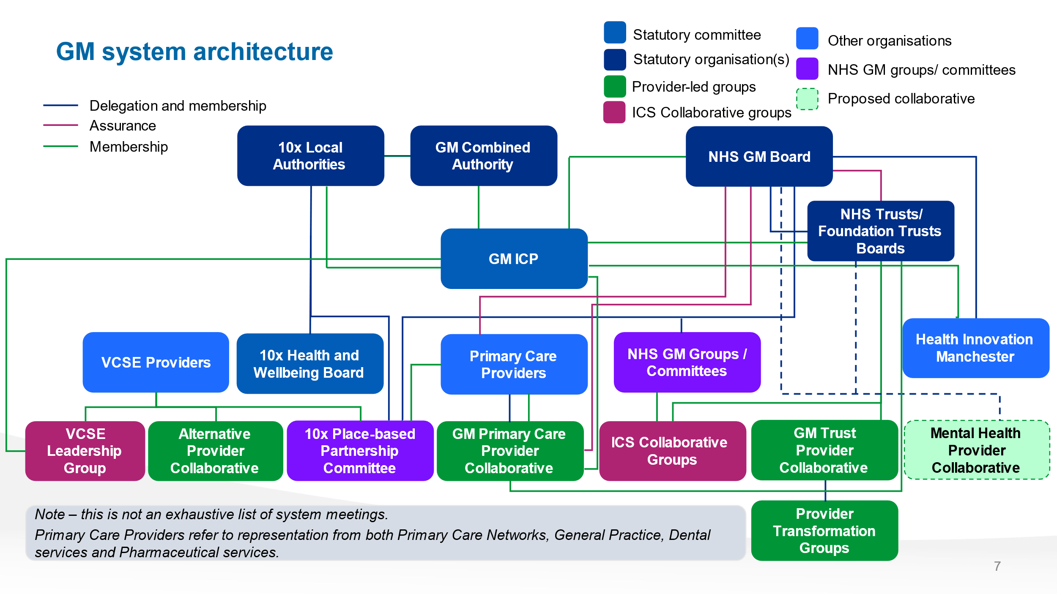
What is the APC?
A way for social business to engage with the GM Integrated Care System.
Provider Collaborative – a partnership that bring together two or more providers of NHS services including hospitals and/or mental health services to work together at scale to benefit their populations (The Kings Fund).
Social Businesses and Charities – all eligible subject to due diligence

Slide 3
The APC in numbers
Currently circa £400m net worth
Annually, 75 partner organisations provide services to around 2 million people.
As a group we have around 3000 staff and engage nearly 1500 volunteers.
Partners in all 10 GM boroughs.

Slide 4

"A body that puts people in control of their own wellbeing and has a mission to achieve health equity is much to be welcomed. The new Greater Manchester Alternative Provider Collaborative shows the importance of pursuing health equity and environmental sustainability at the same time.“
Professor Sir Michael Marmot FRCP
Director, UCL Institute of Health Equity

Slide 5
Strategic Context
NHS reform placing providers in stronger position to influence and shape delivery
APC founded July ‘22 in response to this
Need for parity and respect for organisations that are effective and creative
Sponsored by The Greater Manchester Accord Agreement and GM ICB
Notes:
The APF has emerged following the signing of the GM VCSE Accord Agreement in September 2021. The agreement is a three-way collaboration agreement between the Greater Manchester Combined Authority, the Greater Manchester Health and Social Care Partnership and the GM Voluntary, Community and Social Enterprise (VCSE) Sector represented by the GM VCSE Leadership Group. The Accord will act as a framework for collaboration involving VCSE leaders and organisations in the delivery of the Greater Manchester Strategy, including the development of the strategic plan of the new GM Integrated Care System.

Slide 6
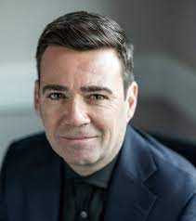
“There are many successful social enterprises already making a difference here in our city-region, and we want to support them to deliver the best possible outcomes for our communities. It’s great to see this new Alternative Provider Collaborative galvanising a collective, coherent platform to work within the wider health and social care system and tackle health inequalities in Greater Manchester.”
Mayor of Greater Manchester, Andy Burnham.

Slide 7
APC – The Purpose
To raise the profile and scale up the social business sector in Greater Manchester
To create an environment where innovation to tackle inequality flourishes
To provide high quality service solutions that support GM residents to Live Well
To bring new investment into the system and increase market share of social business providers
To create an umbrella where smaller providers can expand and are able to participate in GM solutions

Slide 8

APC – Values
Collaboration
Creativity
Influence
Courage
Sustainability
Notes:
Collaboration
Encouraging mutual collaboration can help foster a rewarding and mutually respectful relationship between members. This will help deliver and achieve the overall goals of The APF.
We will create an environment where we can share insight and knowledge and co-produce ideas that support people and communities to get to where they want to be, sharing intellectual property risk free with an open source approach
We will work together on projects cooperatively
Build trust, alignment and accountability
Be inclusive, sharing and connected
Navigate change collectively
Creativity
We will encourage diversity of thought and lived experience in our service development.
We will be a think tank and offer commentary on policy, innovation, testing, prototyping, myth busting, etc.
We will offer innovation and alternatives with provider solutions to insoluble issues within health and social care
Be thought leaders
Influence
We will speak up with a shared voice and use our collective bargaining power
Lobby and be a locus of influence on a local and national platform
Use and expand our links to wider system and other bodies to ensure representation across the new ICB/ICS structure in GM.
Be an exemplar of best practice.
Courage
We will collectively bolster members to be courageous and tenacious when challenging the healthcare status quo in GM
Increase market share for the VCSE sector with a clear offer to the wider ecosystem.
Be fleet of foot, dynamic, nimble, lean, agile and with no red tape,
Be challenging
Call out unwarranted variation in health outcomes
Showcase innovation in terms of access and delivery.
Be aspirational towards smaller organisations
Be proactive in grasping opportunity
Sustainable
We will work towards a buoyant and resilient VCSE sector in GM
Invest & develop – partner through sub-contracting with smaller organisations
Support the sustainability and effectiveness of peers and organisations in APF?
Workforce issues - planning, retention, recruitment, EDI
Social impact/value – commissioning
Be a hub of expertise around procurement and commissioning – the art of the impossible.

Slide 9







With Thanks:

Slide 10


What are our members saying?
“Health and social care will be more accessible to all at various levels and with the VCSE federation bringing creativity and freshness to parts of the system that we know our public are unhappy with.
We are strong and robust and will bring more of a unitedness to being part of health and social care ensuring with have thriving communities across Greater Manchester – Jenny Higson CEO
“Big Life are proud to be a founding member of the GM Alternative Provider Collaborative. With 30 years experience of working with public services to tackle inequalities, we are passionate about working in partnership to make change happen – Fay Selvan CEO

Slide 11
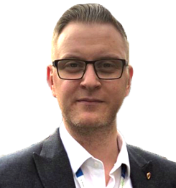
‘As alternative providers in the VCSFE sector we believe it is important to ensure all NHS expenditure is used to realise patient benefit. We are here to ensure that the NHS has provider support options that uphold the ethos of the NHS by enabling community and social value to ensure our communities thrive. With opportunities to commission for health care provision in a deregulated manner, we have come together to ensure that economy is on offer to limit the need for privatisation and to prevent under representation of local voices in Integrated Care System matters. We are together to uphold the value of integration, partnership, best practice and appropriate representation to keep the patient in focus whilst the pound comes under pressure.’ - Timothy A Davison / Director of Operations, Strategy and Transformation Mastercall Healthcare

Slide 12











Supporting organisations:

Slide 13

The partnership between TLC and Just Psychology emerged from discussions within the APC, leading to a swift, cost-effective solution to a critical management and supervision need. By seconding a values-aligned TLC staff member into Just Psychology’s team, we ensured immediate leadership support, seamless team integration, and continuity in service delivery.
This collaboration exemplifies resource pooling by utilising existing expertise, avoiding lengthy recruitment processes, and adapting shared principles to meet evolving needs. Ongoing engagement between CEOs and service managers has fostered leadership support and development while ensuring best practices were upheld without reinventing processes.
Collective learning and flexibility were central to our approach, creating a safe, valued space for staff to maintain service delivery and quality performance with set review periods in place.
A flexible, cost-effective model of high-quality, accessible clinical supervision was established, ensuring consistent professional support. This approach enabled operational capacity within Just Psychology’s senior leadership team, maintaining high quality service delivery while freeing executive leaders to focus on long-term strategic planning during a time of change. This partnership has demonstrated the power of agile, values-driven collaboration in sustaining service delivery whilst driving organisational strategic development. Michelle Hill. Chief Executive Talk Listen Change

Slide 14
How do APC Partners help GM residents to Live Well?
Longstanding commitment and service presence in marginalised communities
Local and diverse workforce creating positive economic impact
Supporting those who may not access mainstream services
Showing positive regard and using an asset-based approach to solutions
Thinking differently about how people access/engage with healthcare
People and communities at the heart of the partnership
Co-production for best outcomes based on collective values and principles
Act as an advocate to call out poor practice in other parts of the system

Slide 15
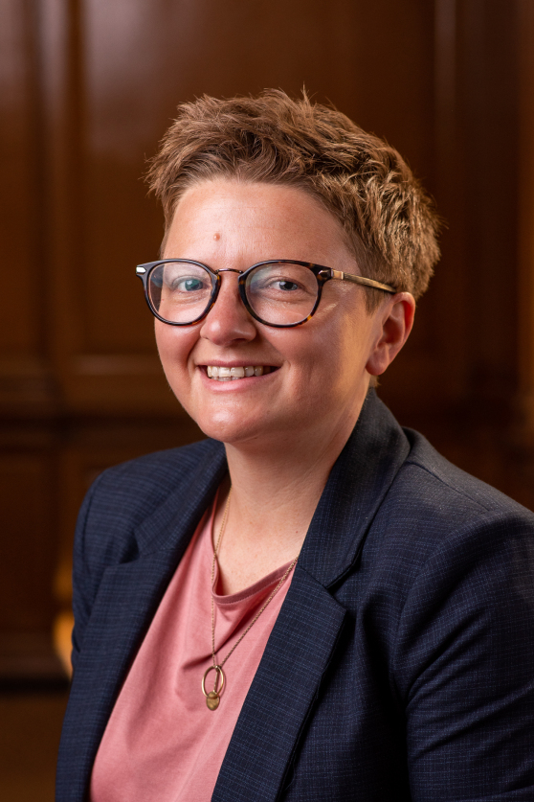
“Great to see the APC having a day to reflect on issues of social justice in GM. Wishing them well and sorry I can’t be there. I’m sure they will continue to make a difference in terms of what is available in GM to improve health and life chances” – Cllr Bev Craig. Leader Of Manchester City Council

Slide 16













Founding partners:

Slide 17
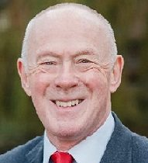
‘The ICB has benefitted from supporting the establishment of the Alternative Provider Collaborative in delivering NHS services in GM.
It is important that we continue to seek new solutions to deliver effective results in reducing health inequality.’ Sir Richard Leese – Chair NHS GM

Slide 18















More APC partners:

Slide 19
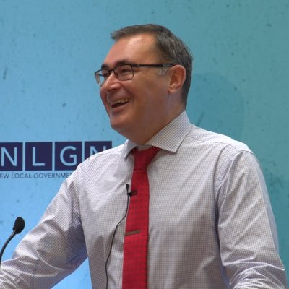
The Alternative Provider Collaborative ensures our approaches to care model and pathway design includes the widest possible range of provider responses. The importance of the APC is that it includes providers with expertise and connection in culturally appropriate services, and to providers responding to patient needs which are not met in mainstream services.
Those providers as GM located, non-profit social businesses also ensure we are developing a care model which fuels an inclusive economy and increases the social value of our commissioned services.
The APC therefore allows us to invite care model development for populations who are not well served by mainstream provision whether in urgent, planned or primary care, physical and mental health. The APC takes the lead on design, responding to commissioner’s challenge and the evidence across qualitative and quantitative data co-producing those models with those communities who’ll benefit and tackling long standing shortcomings in traditional care models.
– Warren Heppolette. Prevention Demonstrator Director - GMCA

Slide 20






With Thanks:

Slide 21
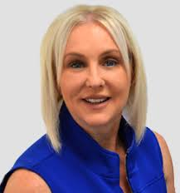
The Alternative Provider Collaborative is a partnership of charities and social businesses operating across the Greater Manchester Integrated Care System. They have delivered outstanding results in transforming the way the VCSE sector engages and collaborates, through an innovative, joined-up approach. By aligning expertise across independent and NHS providers, the Collaborative has created a safe space for shared expertise, best practice, co-production and learning. They have been critical in raising the profile of this important sector representing health and social care through lobbying and local influence. Crucially, the group has championed the opportunities of working in partnership, to make change happen and tackle inequalities. Best practice is not only shared but embedded across services, ensuring consistent, high-quality care. This collaboration exemplifies how collective action can achieve better outcomes, deliver efficiency, and elevate patient experience on a regional scale. Michaela Buck – CEO Mastercall Healthcare

Slide 22
If you’d like to find out more about The APC, become a partner or just meet the team contact us – info@gmapc.org.uk

